Slide 1
Free Electron Laser

Slide 2
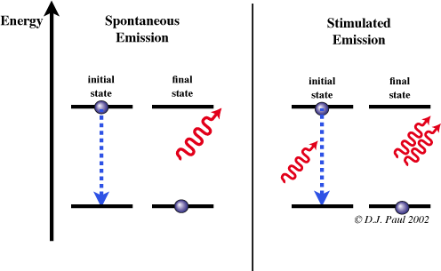
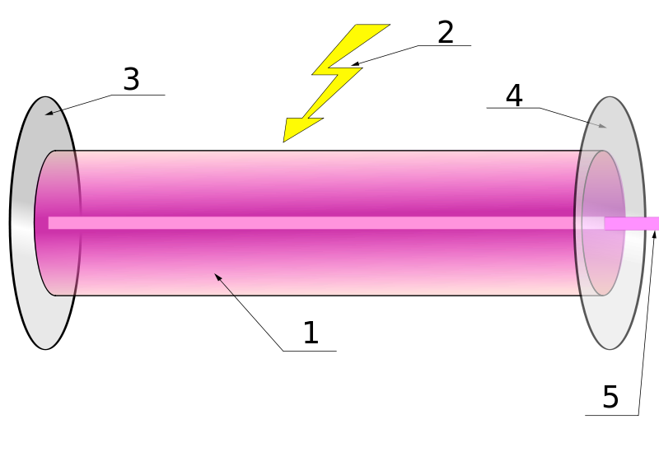
Tradition Laser
1: Gain Medium
2. Pumping energy
3. Reflctor
4. Output coupler
5. Laser output.
@Wikipedia
Materials | Wave length (nm)
CO2 | 10600
TI: Sapphire | 800 (650-1100)
Yb: YAG | 1030
Dye lasers | 390-1000

Slide 3
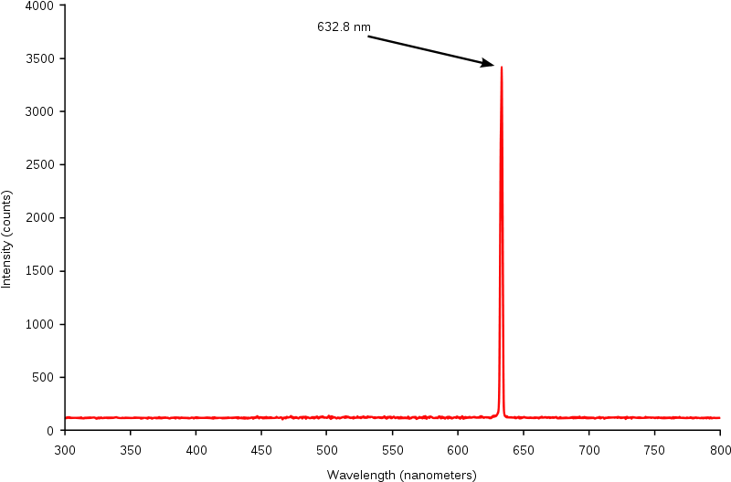
Properties of Laser I
Almost single frequency

Slide 4
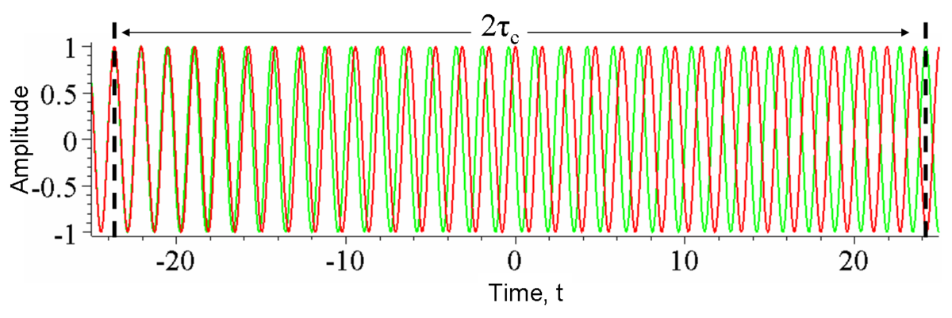
Properties of Laser II
Monochromatic light source leads to ‘temporal coherence’.
Beyond certain time, the wave becomes irrelevant

Slide 5
Properties of Laser III
The coherence time:
And the temporal coherence length

Slide 6
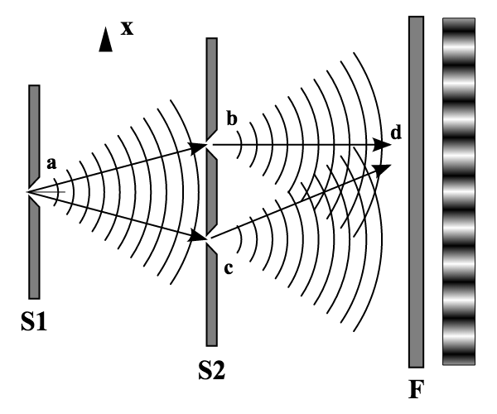
Properties of Laser IV
Spatial coherence
In Young’s experiement the wave at b and c must be coherent
Spatial coherence length:

Slide 7
Gaussian Wave Packet
Emittance:
Rayleigh length:

Slide 8
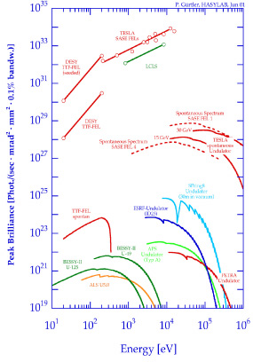
From SR Light Source to FEL
Transversely SR is not coherent.
Emittance in x is ~nm, too large for angstrom x-ray
Longitudinal not coherent
Micro bunching trick

Slide 9
Promising New Lasing Method
Tuning ability, wave length adjustable by undulator strength, or energy of the e-beam
Can reach wavelength region that is lack of traditional laser. (x-ray!)

Slide 10
A Brief History
1951 – Motz showed an electron beam propagating through an undulator magnet could be used to amplify radiation
1960 – Philips developed a microwave tube which is very similar to FEL
1971 – Madey theoretically and experimentally (10μm) proved the possibility of exchanging energy between free electrons and EM radiation
1980 – Infrared radiation FEL (Oscillator)
1984 – Bonifacio et al. brought up the first theory of a SASE FEL in 1-D case
1985 – X-ray FEL
1992 – Proved 0.1nm to 1nm SASE FEL to be possible
2000 – First demonstration of seeded lasing (HGHG)
2009 – 4th generation X-ray light source LCLS successfully commissioned.
On-going – X-ray FEL with high rep. rate; seeded lasing in x-ray range; etc.

Slide 11
Layout: LCLS

Slide 12
LCLS Undulator

Slide 13
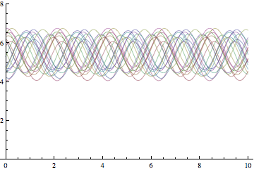
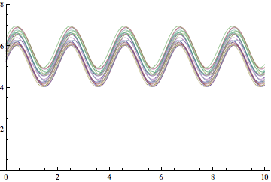
Naïve Idea
e
Incoherent Radiation
e
Coherent Radiation
It is hard to produce such short bunch, 1nm wavelength requires 3e-18 second bunch.

Slide 14
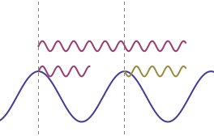
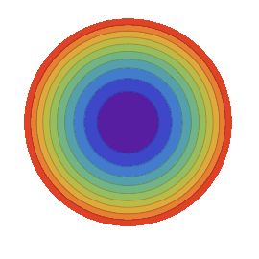
FEL I: The resonance
The energy exchange has its phase as:
In phase
The resonance occurs when:
e
The resonance radiation wavelength at off axis angle ψ

Slide 15
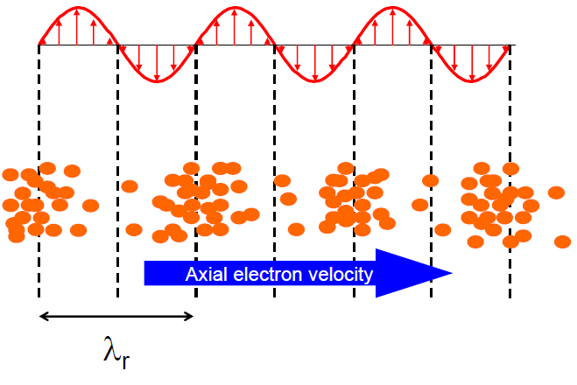
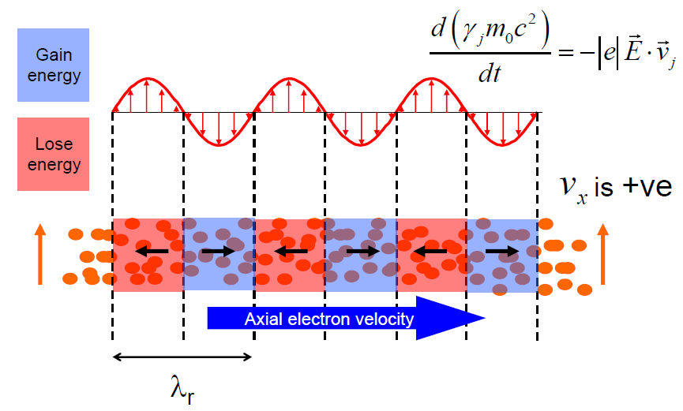
FEL II: Micro-Bunching
The energy change has a sinusoidal form, Therefore:
Or we can write down differential equation for the energy exchange phase and the energy deviation. It is a pendulum equation which defines the separatrix.

Slide 16
Low Gain Regime
We identify a pendulum equation of the phase space variable pair:
Ponderomotive phase
Energy deviation
It is similar to the longitudinal motion.

Slide 17
Low Gain Regime II
No net gain if the average beam energy equals the reference energy,
i.e. the beam is not detuned

Slide 18
Low Gain Regime III
@ P. Schmuser
Madey Theorem
Derivative

Slide 19
FEL Oscillator

Slide 20
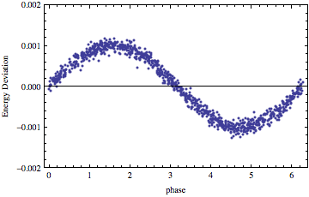
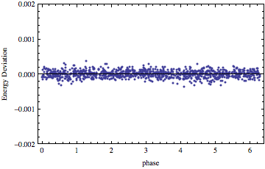
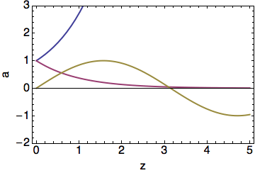
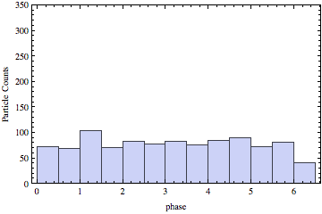
FEL III: Instability Exponential Growth
Jump to the answer directly by assuming
Steady state, no energy spread, ignore transverse detail

Slide 21
High-Gain Regime
The field amplitude is not constant!
Pendulum equation + Maxwell-Vlasov Equation is required.
We use slowly varying phase and amplitude approximation, slow means constant within wavelength:
In 1-D theory, transverse derivative is ignored.

Slide 22
Dimensionless FEL Parameter
The Maxwell equation under this slow approximation:
Choose the FEL scaling parameter, so that the differential equation has constant 1.
Notes:
\tilde E=\frac{E}{2}e^{i\phi}
\left(\frac{\partial}{\partial z}+\frac{1}{c}\frac{\partial}{\partial t}\right)\tilde E=-\Xi_2\left<e^{-i\theta}\right>_\Delta
\frac{d\theta}{dz}=2\eta k_u
\frac{d\eta}{dz}=\Xi_1\left(\tilde E e^{i\theta}+\tilde E^* e^{-i\theta}\right)
\Xi_2=\frac{eK[JJ]n_e}{4\epsilon_0 \gamma}

Slide 23
Solving the Equation
The evolution dominated by the growth mode:
Notes:
\mu_1=1, \mu_{2/3}=\frac{-1\pm\sqrt{3}i}{2}

Slide 24
Gain Length and FEL parameter
The Power Gain length under 1-D Assumption:
The FEL parameter ρ
A dimensionless parameter
Given without proof:

Slide 25
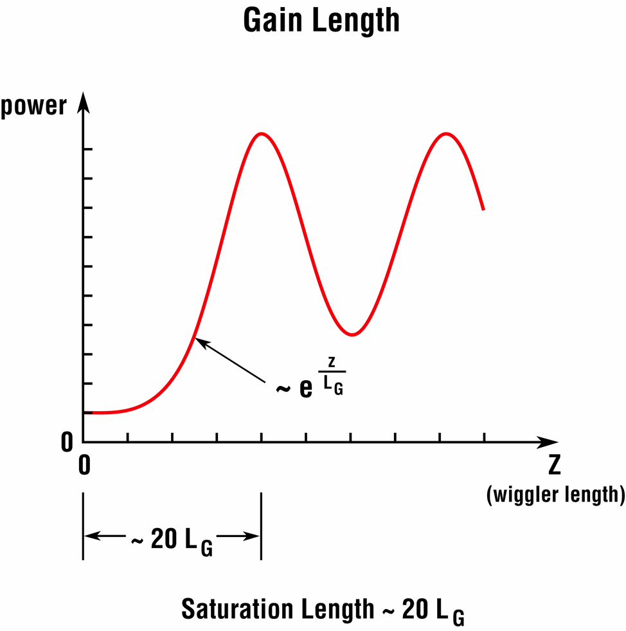
FEL Evolution

Slide 26
Beam Quality Requirement
Energy spread:
Beam emittance:
Beam size
Beam current:
Large enough to get reasonable FEL parameter

Slide 27
3-D Effects
3-D effect include both EM wave and particle:
Electron Emittance
Parameter
Electron Energy
Spread Parameter
Diffraction of
Radiation

Slide 28
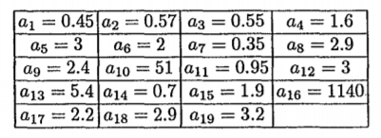
Ming-Xie 3D Parameterization
F function is retrieved by fitting:
The fitting coefficients are:

Slide 29
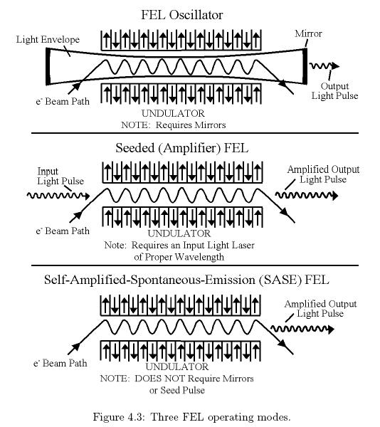
Initial Conditions and FEL Schemes
The coupled differential equation can start from different initial condition
Initial EM wave (Case 1 and 2)
Initial bunching factor (Case 3)
1
2
3

Slide 30
RoadMap to X-ray Laser
SASE, do not need x-ray seed. Generate X-ray pulses from nose, poor longitudinal coherence
Higher harmonic generation, start from large wavelength, obtain its higher harmonic as seed.
SASE self-seeding, apply monochromator in the part of SASE radiation, and use it as seed for the second part.
X-ray FEL oscillator

Slide 31
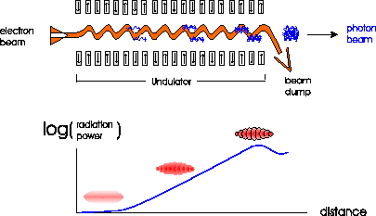
SASE: Born from Noise

Slide 32
FEL Saturation
Energy spread becomes too large to maintain reasonable gain.
Our theory also break since the Vlasov approach assumes the distribution perturbation is small.

Slide 33
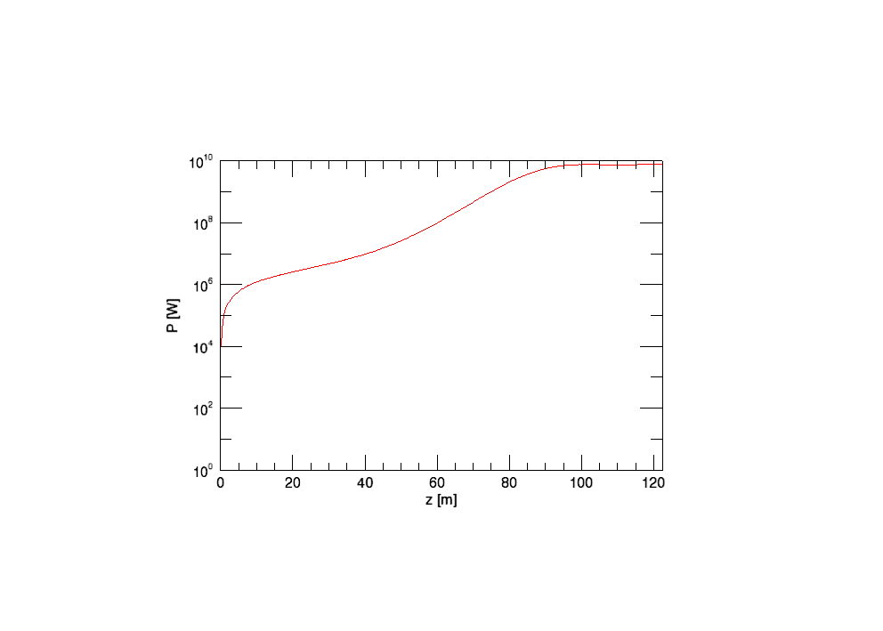
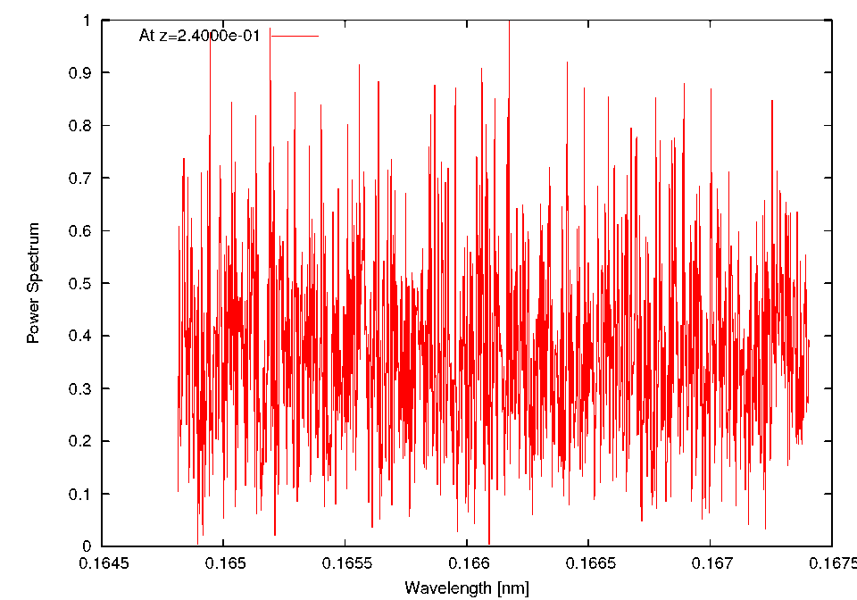
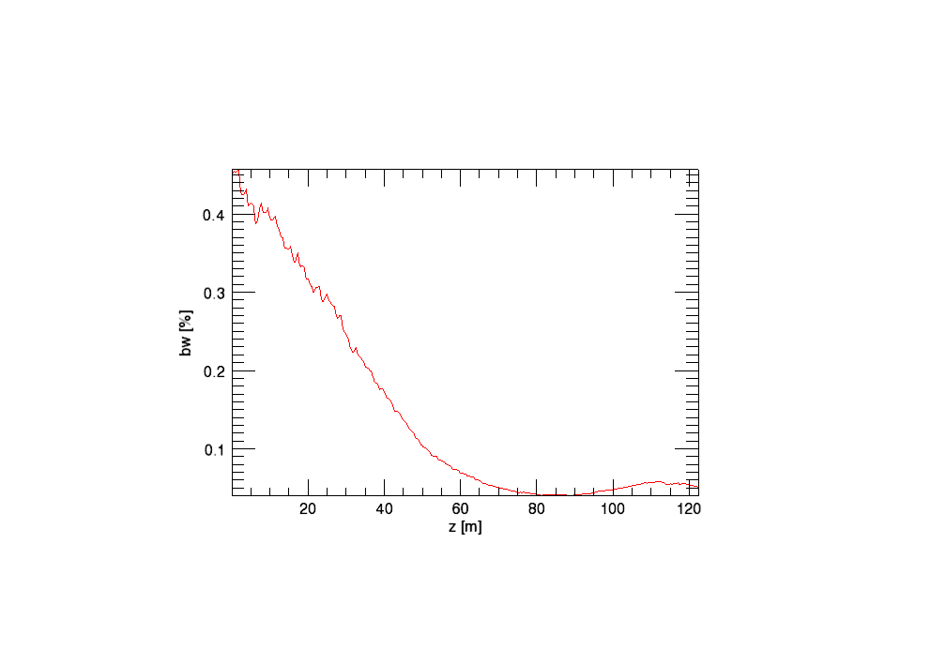
Frequency Spectrum
The SASE frequency spread evolves as

Slide 34
Transverse Mode
The lowest transverse mode has largest gain and becomes dominant. This is usually referred as ‘optical guiding’.
SASE has transverse coherence at or near saturation.

Slide 35
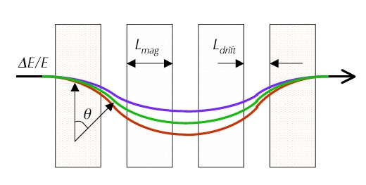
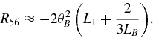
Higher Harmonic Generation Useful tool: Chicane

Slide 36
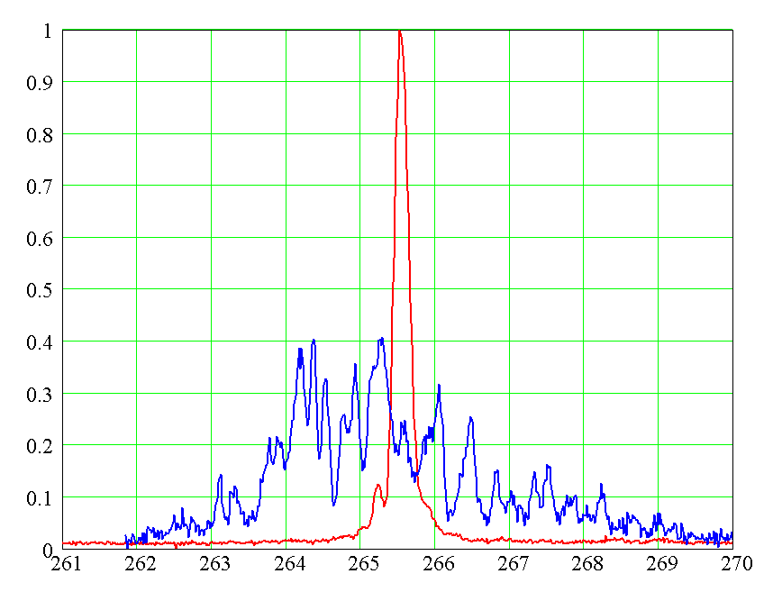
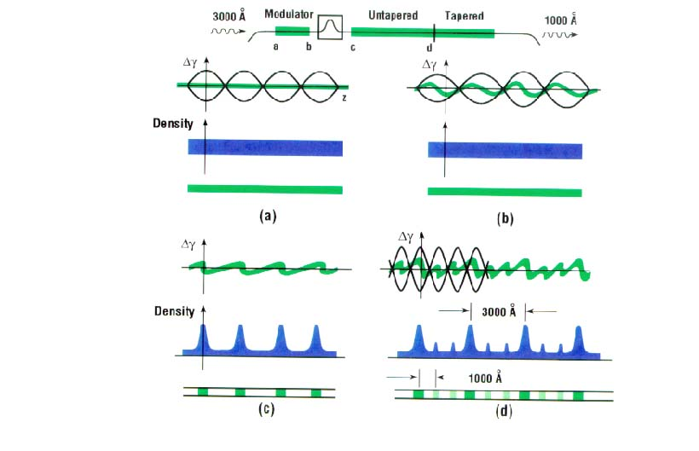
High Gain Harmonic Generation
L.H. Yu et al

Slide 37
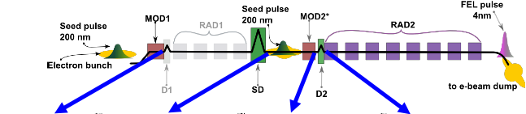
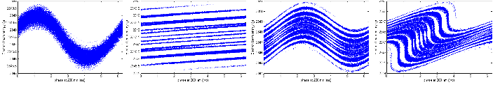
Echo-Enabled Harmonic Generation
@G. Stupakov, Phys. Rev. Lett. 102, 074801 (2009).
Picture from FEL 2010 presentation

Slide 38
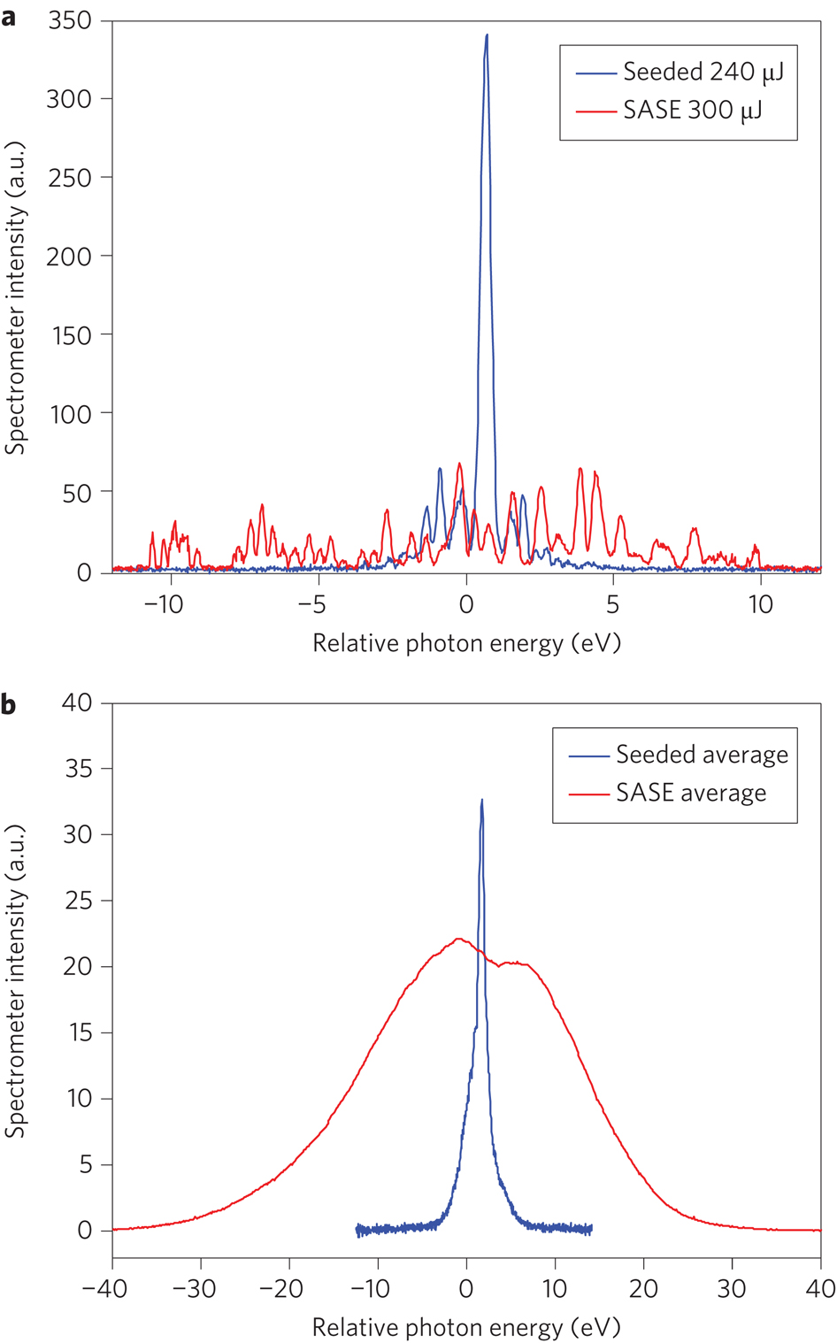
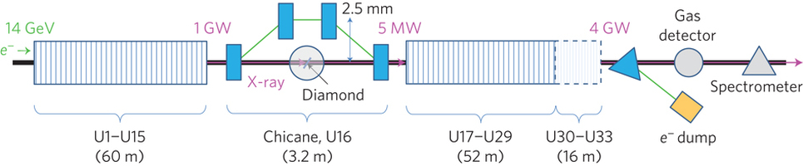
Self-Seeding SASE

Slide 39
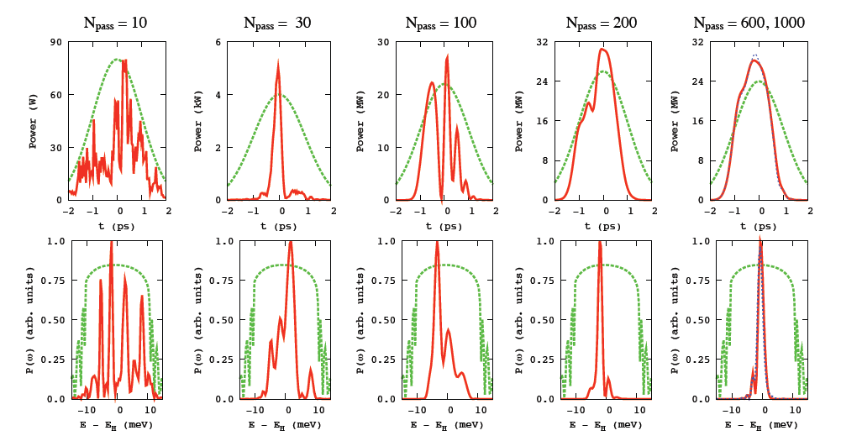
X-ray FEL amplifier
@ K-J Kim

Slide 40
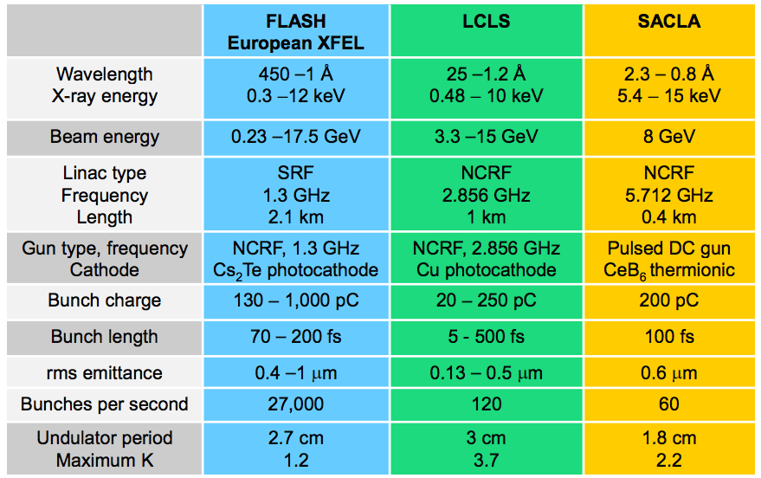
Comparison of 3 X-ray sources
LCLS-II in progress: 4 GeV SRF + 1M rep. rate
LCLS-II-HE planned: 8 GeV SRF + 1M rep. rate

Slide 41
SwissFEL, 2016

Slide 42
FERMI @ Elettra
Cascade seeded FEL

Slide 43
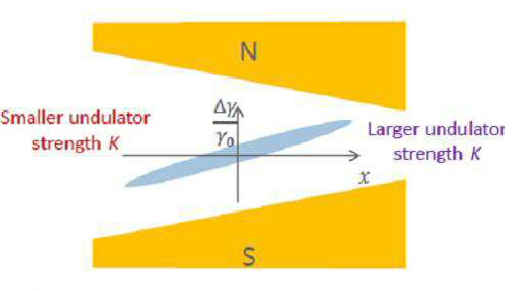
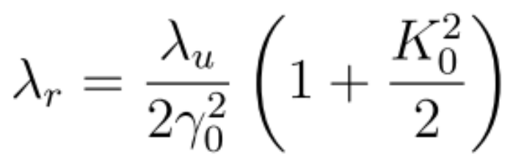
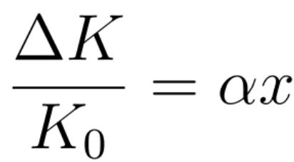
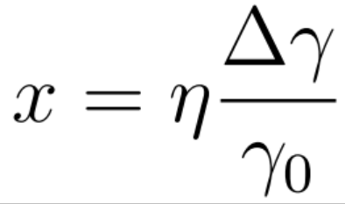
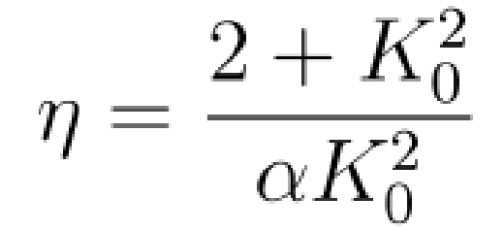
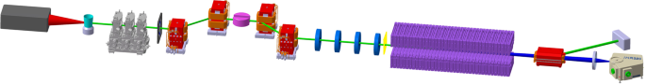
Deal with large energy spread
Some beam has large energy spread, so that δe>ρ.
Solution : Transverse Gradient Undulator

Slide 44
References
K-J. Kim and Z. Huang USPAS Lecture Notes
D. Nguyen and Q. Marksteiner USPAS Lecture Notes

